Slide 1
MongoDB
MongoDB Modeling by Zongqi Lyu

Slide 2
Introduction to modeling
Differences between NOSQL and SQL database
Flexibility

Slide 3
Data Modeling in MySQL
Define data model
Develop application and queries
Have to be normalized
Data dictates application

Slide 4
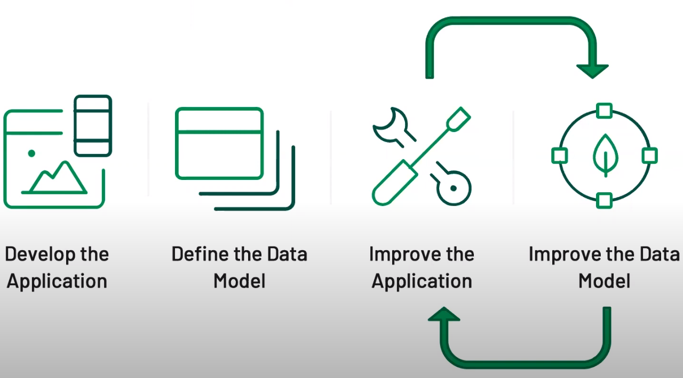
Data Modeling in MongoDB

Slide 5
Achieve a better data modeling
Data model is defined at the application level
Design is part of each phase of the application lifetime
What affects the data model

Slide 6
Step-by-step Design
Evaluate the application workload
Map out entities and their relationships
Finalize the data model for each collection

Slide 7
Document Structure
Reference (Normalized Data)
Embedded (Denormalized Data)

Slide 8
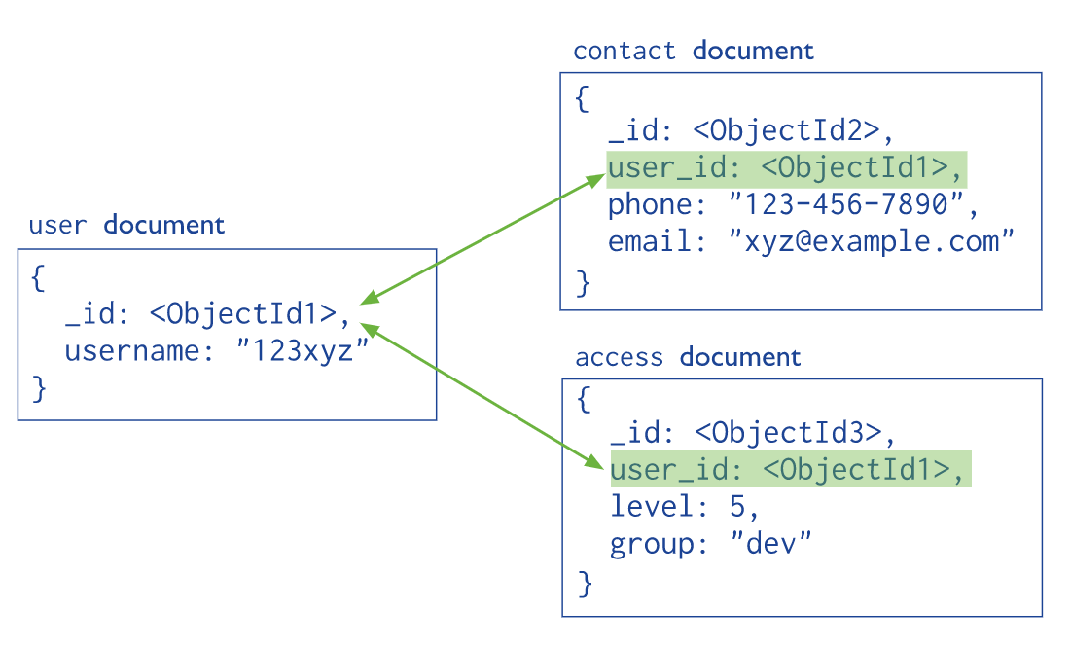
Reference

Slide 9
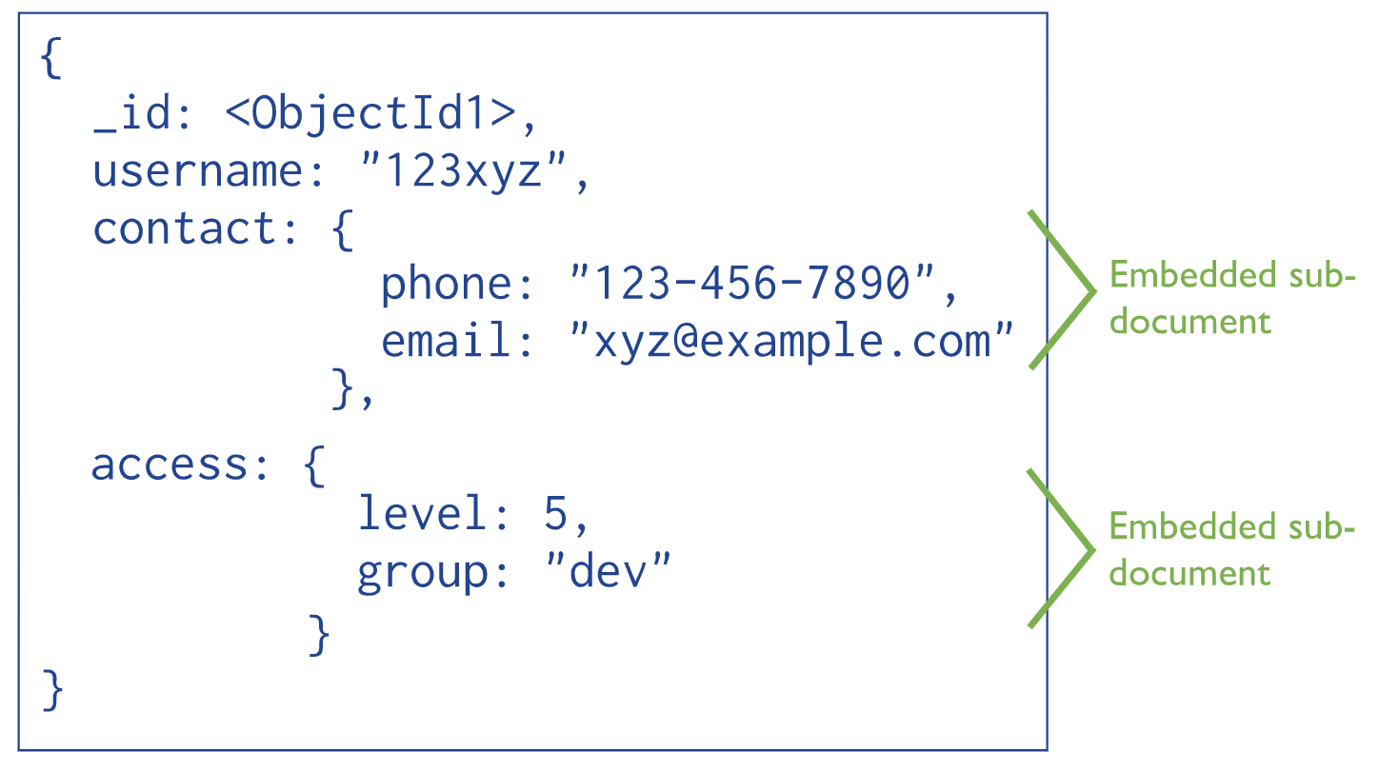
Embedded Data

Slide 10
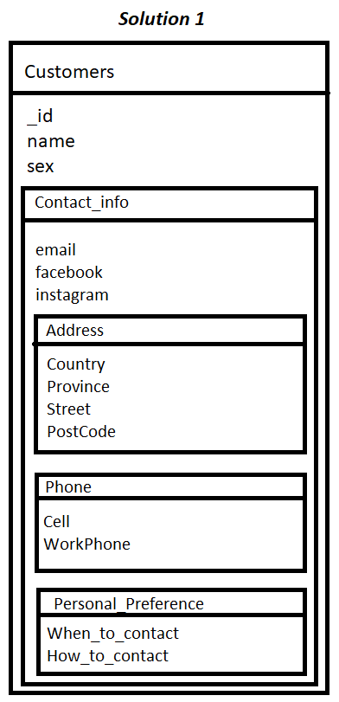
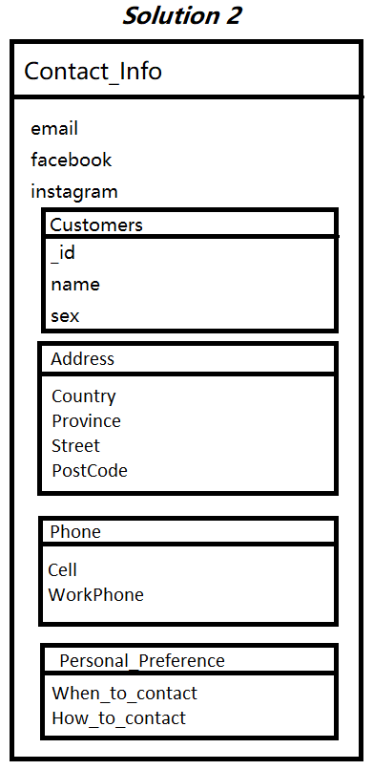
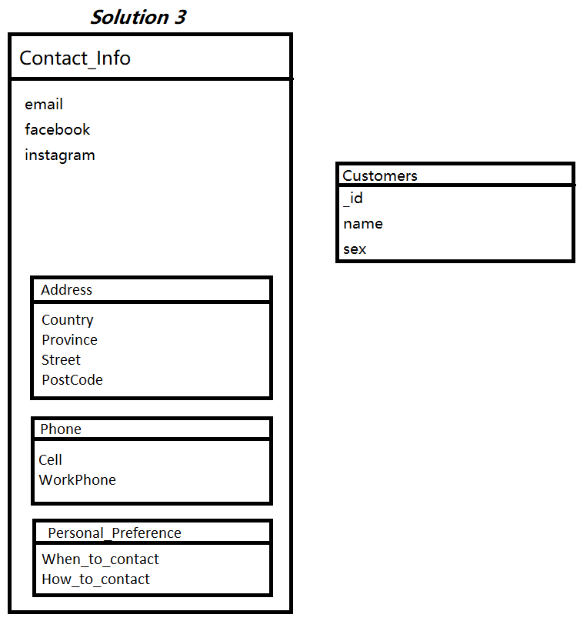
Flexible Data Modeling Solutions

Slide 11
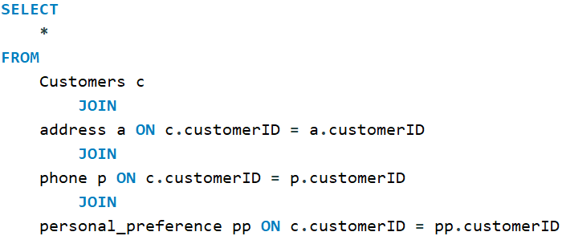
Queries
db.customers.find({"customerID" : "0001"})

Slide 12
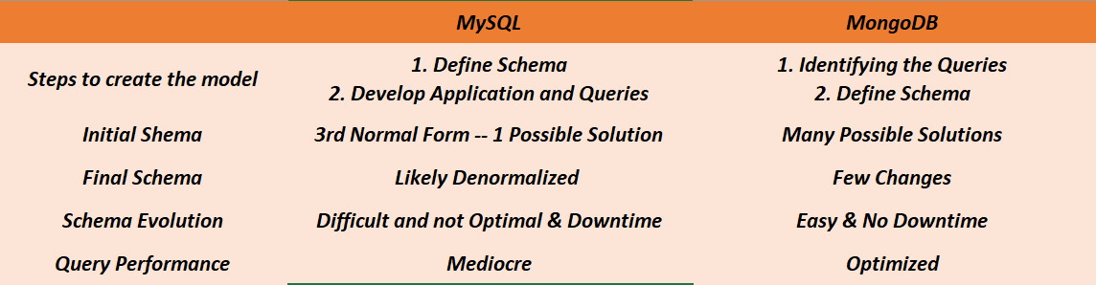
Summary

Slide 13
Schema Validation
Schema + Validation

Slide 14
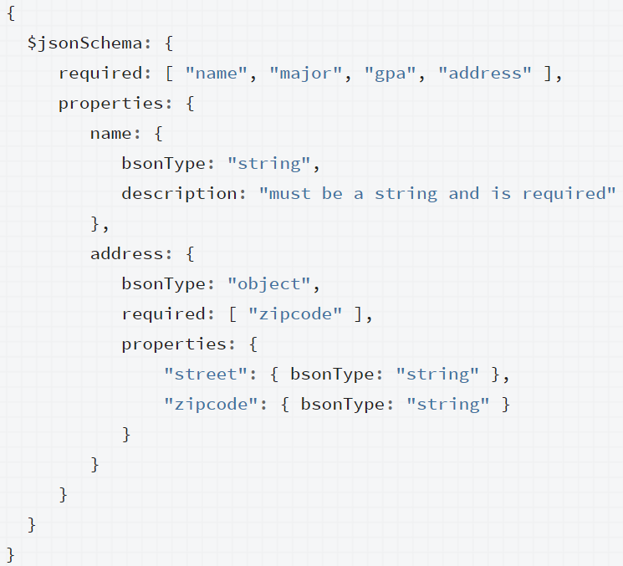
JSON Schema

Slide 15
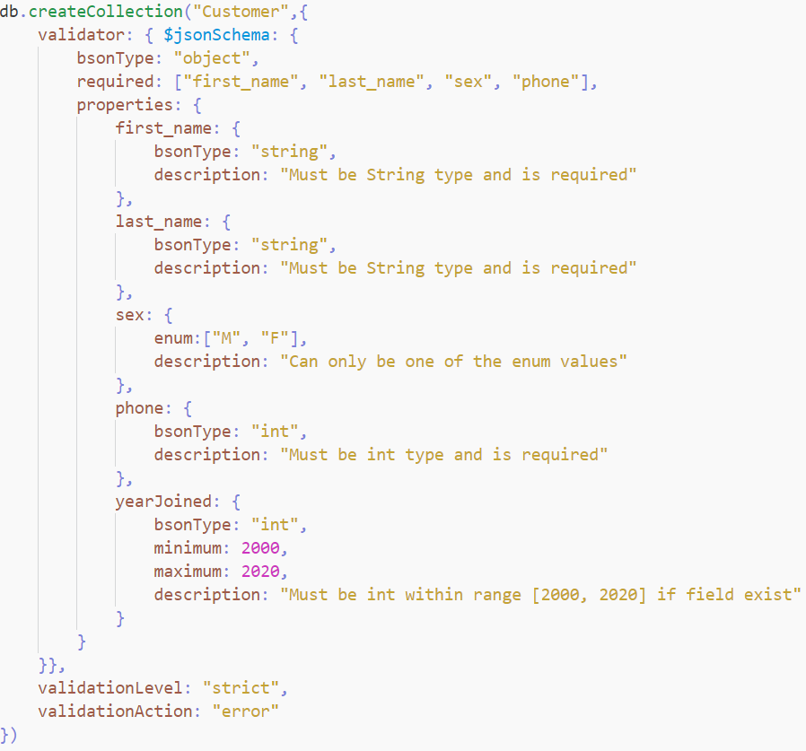
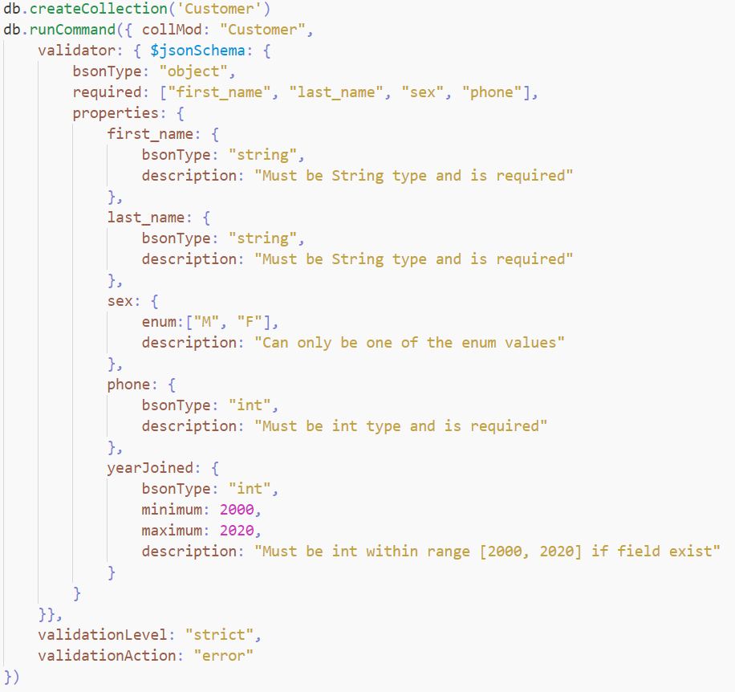
Schema Validation

Slide 16
Schema Validation Cont.
validationLevel:
“off”
“strict”
“moderate”
validationAction:
“error”
“warn”

Slide 17
Vscode X MongoDB
Node js
npm init
npm install mongoose mocha nodemon
Change test in package.json to “mocha”

